Slide 1
MMAC COVID-19 Update 04.13.2021
PRESENTED BY:
John R. Raymond Sr., MD

Slide 2
COVID-19 update 04.13.2021
LEARN MORE AT
Covid19.MCW.com
John R. Raymond Sr., MD
President and CEO
Medical College of Wisconsin
PRESENTED BY:
Analytics by Ali Nemati
MCW Institute for Health and Equity

Slide 3
COVID-19 DIAGNOSTIC TESTING – 04.12.2021
LEARN MORE AT
Covid19.MCW.com
DAILY POSITIVE CASES
WISCONSIN & MILWAUKEE
585,710
TOTAL CASES IN WI
102,440
TOTAL CASES IN MILWAUKEE COUNTY
7,989
PREVIOUS HIGHEST DAILY POSITIVE CASES IN WISCONSIN
11.18.2020
1,649
PREVIOUS HIGHEST DAILY POSITIVE CASES IN MILWAUKEE
11.09.2020
402
POSITIVE CASES
IN WISCONSIN YESTERDAY
12.7%
CASE POSITIVITY
IN WISCONSIN YESTERDAY
16.2%
7-DAY AVERAGE
IN WISCONSIN
TRENDING UNFAVORABLY
16.7%
7-DAY AVERAGE
IN MILWAUKEE
TRENDING UNFAVORABLY
115
POSITIVE CASES
IN MILWAUKEE YESTERDAY
17.1%
CASE POSITIVITY
IN MILWAUKEE YESTERDAY

Slide 4
VARIOUS COVID-19 INDICATORS – 04.12.2021
LEARN MORE AT
Covid19.MCW.com
CUMULATIVE DEATHS
WISCONSIN & MILWAUKEE
% OF CASES BY RECOVERY STATUS
97.4%
RECOVERED
1.4%
ACTIVE
1.1%
DIED
6,680
IN WISCONSIN
1,271
IN MILWAUKEE
7.2%
BLACK/
AFRICAN AMERICAN
25.7%
BLACK/
AFRICAN AMERICAN
54.2%
MALE
86.4%
WHITE
54.4%
MALE
57.1%
WHITE
45.7%
FEMALE
5.8%
HISPANIC/LATINX
45.6%
FEMALE
12.9%
HISPANIC/LATINX
SOURCE: X

Slide 5
KEY TAKEAWAYS
LEARN MORE AT
Covid19.MCW.com
WI is doing better now than during the Spring, Summer and November surges of 2020; BUT, cases and hospitalizations are rising. Cases are averaging 789 per day, up from recent 7-day average low of 363 on 03.11.2021. Hospitalizations are up 50% since low of 193 was reported on 03.21.2021
7-day average for new US daily cases has risen from under 50,00 in mid-March to 69,632. Hospitalizations are up 9% in the US. However, deaths in US are still trending downward.
State trends are variable, with surges in Michigan, NY, and NJ. Minnesota cases continue to rise. Illinois cases have increased 50% over last two weeks. Deaths are rising in Minnesota and Michigan.
Competing forces… increasing COVID-19 vaccinations vs pandemic fatigue + more contagious variant strains.

Slide 6
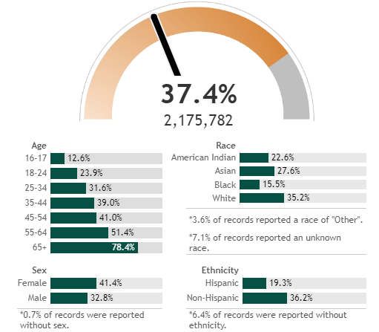
WISCONSIN COVID-19 VACCINE DISTRIBUTION
LEARN MORE AT
Covid19.MCW.com
WISCONSIN POPULATION WHO HAVE RECEIVED ONE VACCINATION
WISCONSIN IS
10th of 55 US states and territories FOR ONE DOSE and COMPLETED COURSES
AS OF 04.11.2021
1 in 3 IN USA
HAVE RECEIVED AT LEAST ONE VACCINATION
AS OF 04.11.2021
MILWAUKEE IS LAGGING, BUT IS CATCHING UP
USA – 3 MILLION SHOTS PER DAY
WISCONSIN – NEARLY 400K/WEEK
https://coronavirus.jhu.edu/region/us/wisconsin#vaccine-tracker
https://www.dhs.wisconsin.gov/covid-19/vaccine-data.htm#day

Slide 7
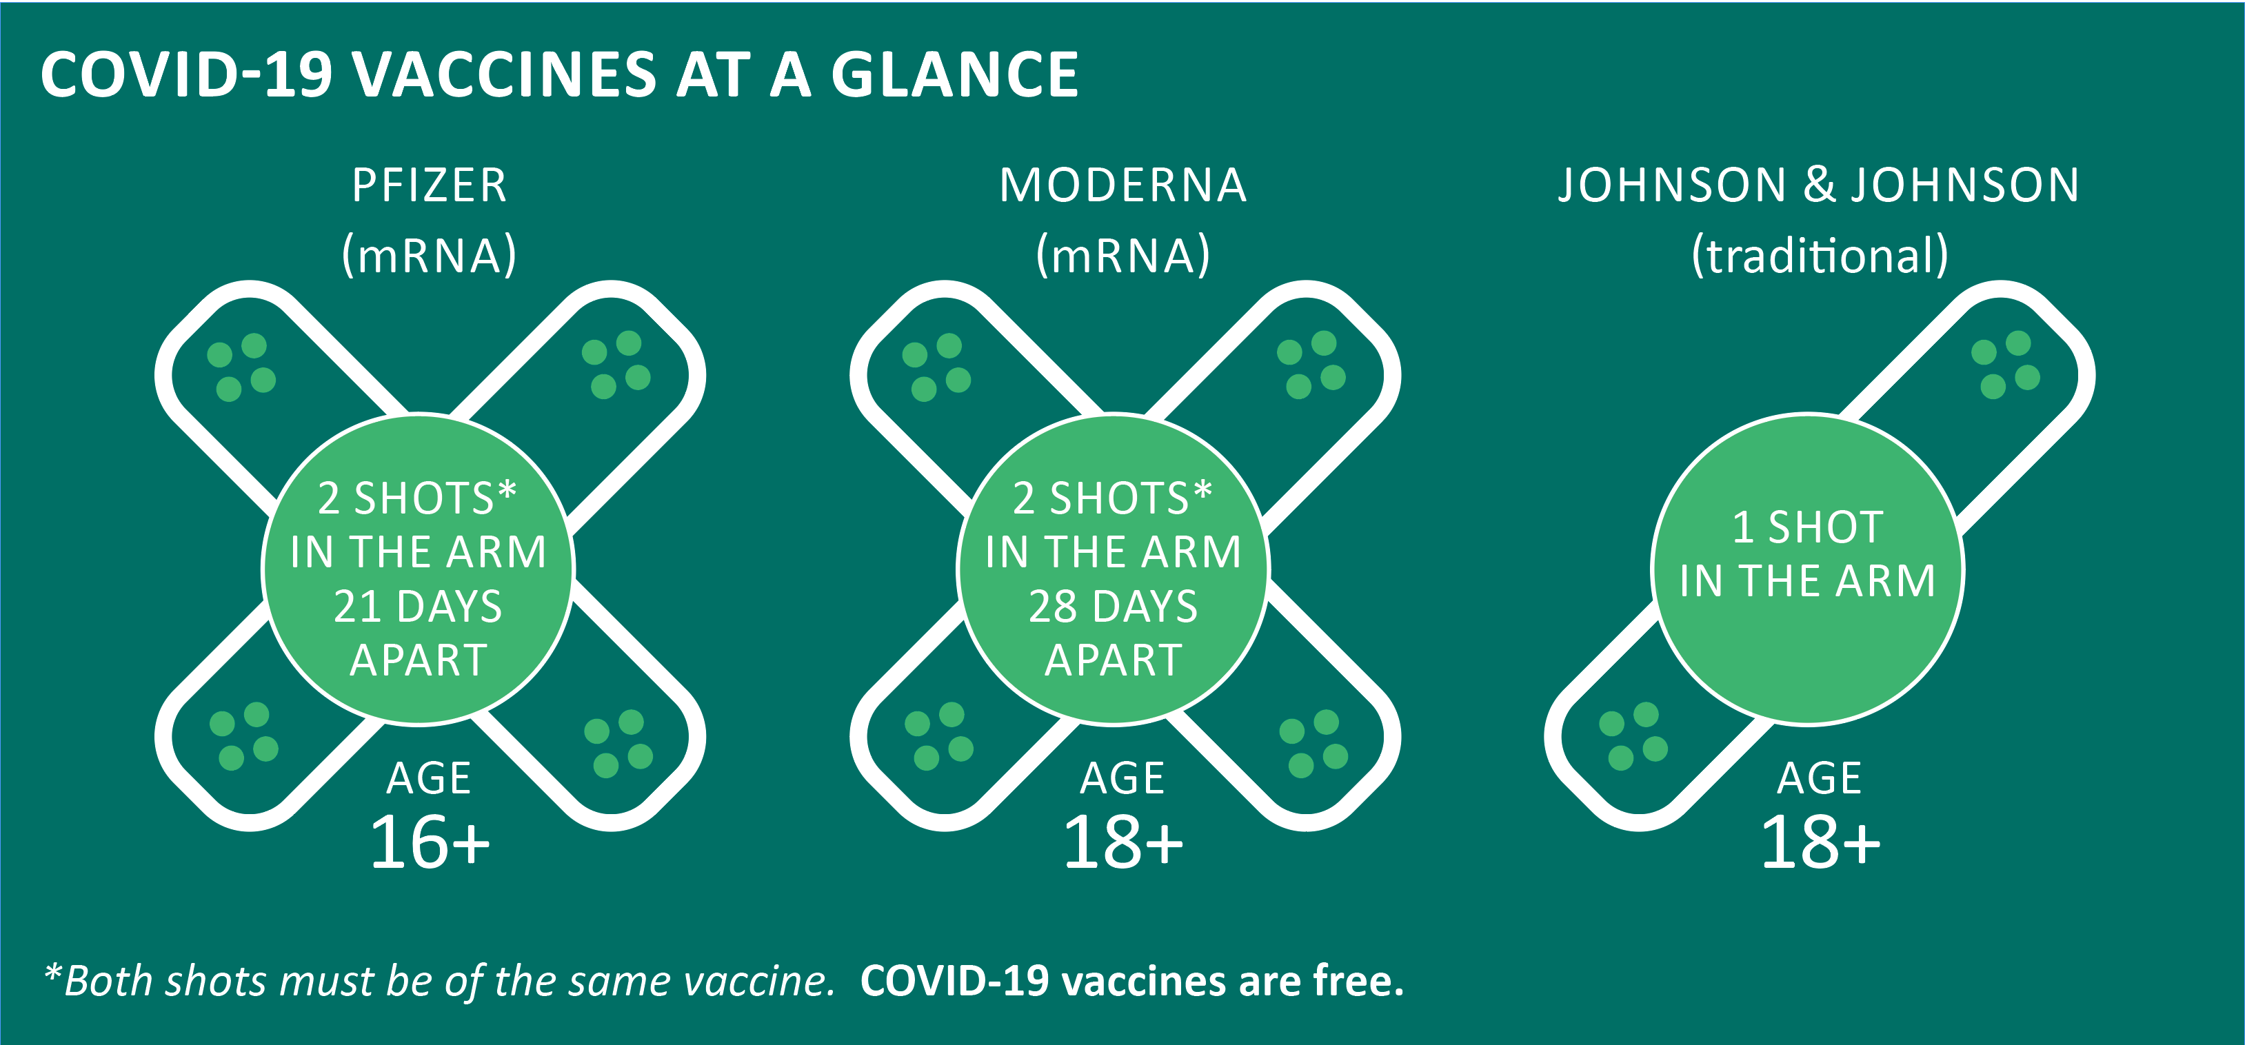
COVID-19 VACCINE COMPARISONS
LEARN MORE AT
Covid19.MCW.com
All vaccines were held to the same rigorous safety and effectiveness standards as all other vaccines in the United States
All vaccines were found to be highly effective at protecting against COVID-19
All vaccines teach the body to protect itself
None of the vaccines contain a live virus and cannot give you COVID-19
After receiving the vaccine, you may experience tenderness at the injection site, fatigue, low-grade fever, headache, or muscle/joint soreness – these should go away within a day or two
For more information, and to stay up to date on vaccine eligibility, visit: healthyMKE.com

Slide 8
VACCINE CONFIDENCE
LEARN MORE AT
Covid19.MCW.com
More than 788 M COVID-19 vaccine doses have been administered worldwide.
US is first in world for total vaccinations (187 M); and has higher percentage of individuals who have completed the series (22%) than most of the rest of the world. We are behind Israel (56%); Seychelles (41%); Chile (25%); Bahrain (25%); San Marino (23%); and Monaco (23.0%).
Wisconsin has a higher percentage of individuals who have received at least one vaccine dose (37.4%) than much of the rest of the country and is on par with or better than neighboring states.
Three authorized vaccines in USA are highly effective – differences in reported efficacy should not be directly compared to each other.
No trials have been done to compare efficacy
They were tested at different points in time, with different test subjects, different strains, and different outcome measures.

Slide 9
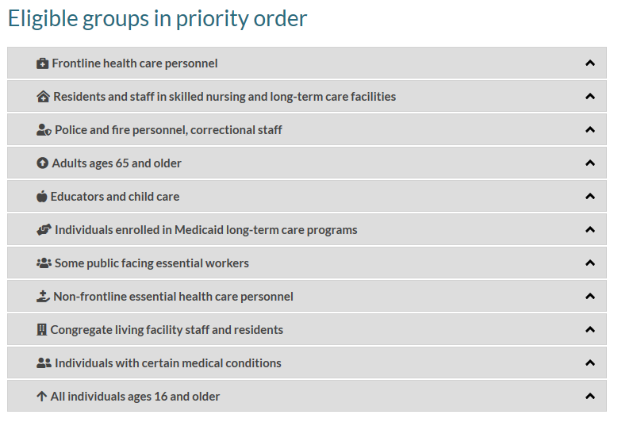
VACCINE ELIGIBILTY IN WISCONSIN
LEARN MORE AT
Covid19.MCW.com
Eligibility is based on recommendations from the CDC and decisions by state and local health authorities.
All individuals age 16 and over were eligible as of
April 5

Slide 10
WHEN CAN WE DO THE THINGS WE MISS?
LEARN MORE AT
Covid19.MCW.com
When we’ve reached herd immunity (70-80+% of adults & children).
Burden of disease is considered “Low” in all counties by DHS.
As of last Wednesday, no counties in Wisconsin had low activity levels.
Ten counties had “medium activity”; and 61 counties had “high levels” of activity. St. Croix county had very high levels.
When we know more about the effectiveness of the vaccines for the new strains, and how well previous infection prevents reinfection. The Brazilian “P1” strain is of concern for re-infection; and the South African “B.1.351” strain is of concern for vaccine ineffectiveness. Four P1 cases have been detected in WI, and 15 cases of B1.351 thus far. 148 cases of UK B.1.1.7 have been detected. 216 cases of B1.427/B.1.429 (California) have been detected. All four strains are “variants of concern”.
CDC classifies variants by 3 levels
VARIANTS OF INTEREST
Specific markers predicted to impact biology
VARIANTS OF CONCERN
Evidence of increased transmission or virulence or escape from immunity
VARIANTS OF CONSEQUENCE
Clear evidence that prevention or treatment measures are ineffective

Slide 11
KEEP FOLLOWING THE 3Ws
LEARN MORE AT
Covid19.MCW.com
WEAR A MASK
WATCH YOUR DISTANCE
WASH YOUR HANDS

Slide 12
DATA SOURCES
Data sources
LEARN MORE AT
Covid19.MCW.com
WE USE MULTIPLE EXTERNAL DATA SOURCES FOR THESE PRESENTATIONS
Wisconsin Hospital Association: wha.org/COVID-19Update
Wisconsin Department of Health Services: https://www.dhs.wisconsin.gov/covid-19/index.htm
Milwaukee County: https://county.milwaukee.gov/EN/COVID-19
https://covidtracking.com/
New York Times: https://www.nytimes.com/interactive/2020/us/coronavirus-us-cases.html
and https://www.nytimes.com/interactive/2020/science/coronavirus-vaccine-tracker.html
Wisconsin Electronic Disease Surveillance System (secure access required)
Milwaukee County Unified Emergency Operations Center (secure access required)
Centers for Disease Control and Prevention: https://www.cdc.gov/coronavirus/2019-ncov/community/health-equity/race-ethnicity.html
Worldometers: https://www.worldometers.info/coronavirus/
Johns Hopkins: https://coronavirus.jhu.edu/vaccines
MEDICAL COLLEGE OF WISCONSIN ANALYTICS
Institute for Health and Equity
Division of Epidemiology
Epidemiology Data Resource Center and Geographic Information System

